Slide 1
Model Selection and Regularization on Prediction of Survival on the Titanic
By Tse Justin Chung Heng

Slide 2
Goal and focus of this project
Reproducing the Hitter’s salary problem (ISLR Chapter 6)
With different dataset and classification vs regression
Focus on 4 model selection methods
Model-based approach(Subset selection approach)
AIC
BIC
Regularization approach
Ridge
Lasso

Slide 3
Dropping features
Drop the Cabin
Drop the Ticket

Slide 4
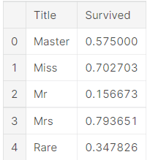
Creating new feature

Slide 5
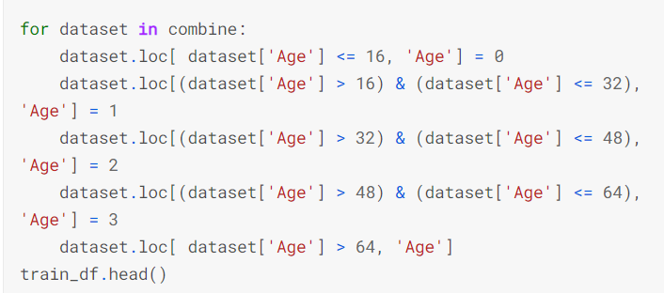
Categorize age

Slide 6
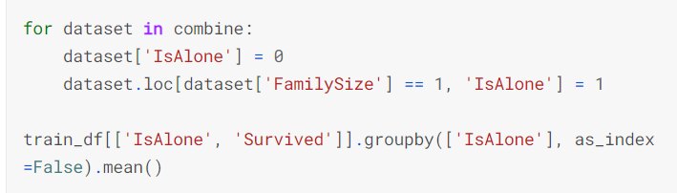
Drop Parch, SibSp, and FamilySize
And create IsAlone feature

Slide 7
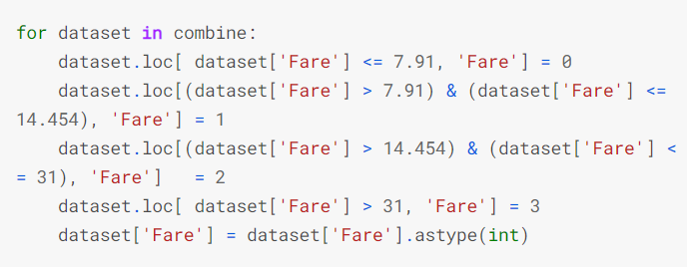
Categorize fare

Slide 8
And some other preprocessing
Fill in some empty data
convert categorical data to numerical
...

Slide 9
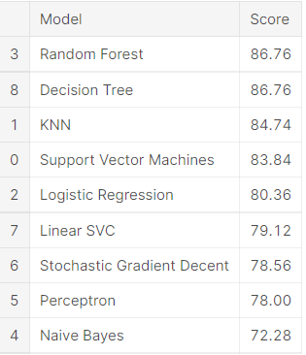
Logistics regression not the best
However, to comply with the goal, I only focus on logistic regression

Slide 10
Model-based approach(Subset selection approach)
Use AIC and BIC combine with best subset selection.
May not be viable in other dataset
This dataset is small, so search space still managable (256)
Total elapsed time: 2.4581050872802734 seconds for best subset
Total elapsed time: 0.369549036026001 seconds for forward selection
Not consider forward/ backward stepwise selection

Slide 11
AIC in logistics regression
AIC = -2/N * LL + 2 * k/N
Where N is the number of examples in the training dataset, LL is the log-likelihood of the model on the training dataset, and k is the number of parameters in the model.

Slide 12
BIC in logistics regression
BIC = -2 * LL + log(N) * k
Where log() has the base-e called the natural logarithm, LL is the log-likelihood of the model, N is the number of examples in the training dataset, and k is the number of parameters in the model.

Slide 13
No R-squared in logistics regression
Possible replacement is McFadden's pseudo-R-squared
Not in this project

Slide 14
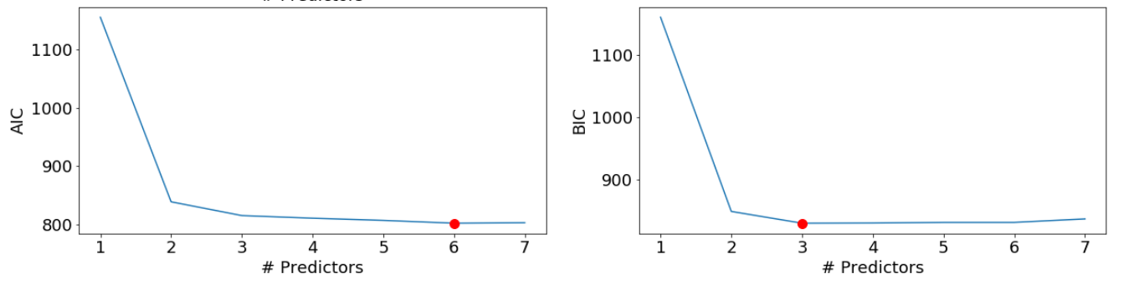

Slide 15
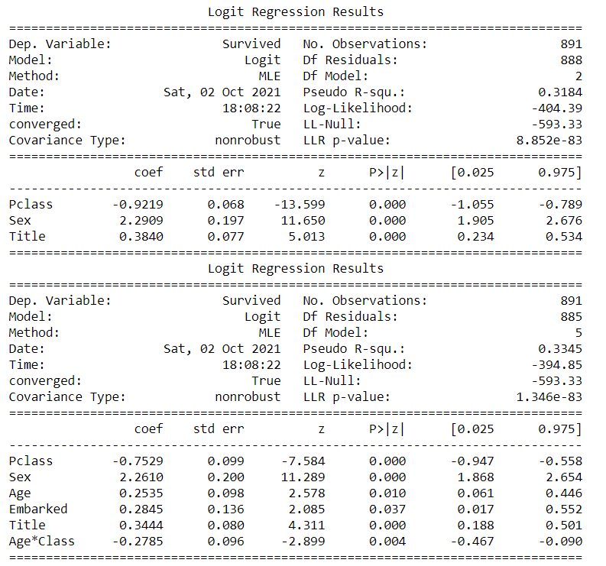

Slide 16
Regularization approach
Ridge and Lasso

Slide 17
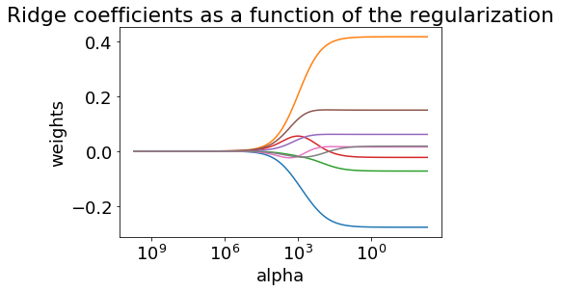
Ridge
Use 5-fold CV

Slide 18
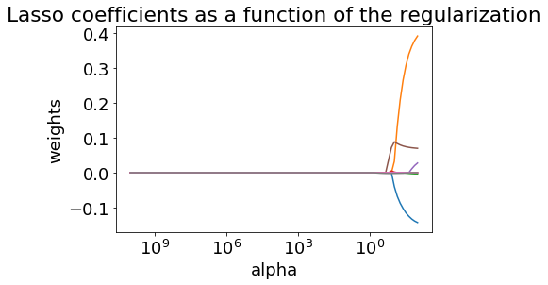
Lasso
Use 5-fold CV

Slide 19
Summary
​ | 1. AIC​ | 2. BIC​ | 3. Ridge​ | 4. Lasso​
Number of parameters​ | 6​ | 3​ | 8​ | 5​
Parameter​ | Pclass -0.7529 ​ Sex 2.2610 ​ Age 0.2535 ​ Embarked 0.2845 ​ Title 0.3444 ​ Age*Class -0.2785​ | Pclass -0.9219 ​ Sex 2.2909 ​ Title 0.3840​ | Pclass -0.255532 ​ Sex 0.397340 ​ Age -0.056094 ​ Fare -0.006139 ​ Embarked 0.061012 ​ Title 0.149729 ​ IsAlone 0.016209 ​ Age*Class 0.002501​ | Pclass -0.119751 ​ Sex 0.202281 ​ Age -0.016549 ​ Embarked 0.021558 ​ Title 0.064091 ​
Training Accuracy​ | 0.8​ | 0.78​ | 0.74​ | 0.81​
Test Accuracy(from Kaggle)​ | 0.76794​ | 0.76794​ | 0.74162​ | 0.77033​

Slide 20
Result
The result is consistent with what we learnt from the lab of Chapter 6 of ISLR.
The BIC penalizes more heavily for additional parameters than AIC.
LASSO often shrinks coefficients to be identically 0.
All method yield similar result in term of accuracy and general importance of certain parameters.

Slide 21
Result
Finding specific to this dataset:
Pclass, Sex and Title appear in all 4 models.
Sex is the highest positive coefficient in all 4 models, which may indicate that female(Sex =1 ) has higher likelihood to survive in the disaster.
Pclass is the highest negative coefficient in all 4 models, which may indicate that the lower the class you were, the less likely you would survive.

Slide 22
Mistakes and improvement
Include base model without regularization
Embarked and Title feature should use one-hot encoding because it is nominal data

Slide 23
Reference
https://machinelearningmastery.com/probabilistic-model-selection-measures/
https://stats.idre.ucla.edu/other/mult-pkg/faq/general/faq-what-are-pseudo-r-squareds/
https://www.kaggle.com/startupsci/titanic-data-science-solutions

Slide 24
Q&A

